Slide 1
Data processing
ETL: Extract > Transform > Load

Slide 2
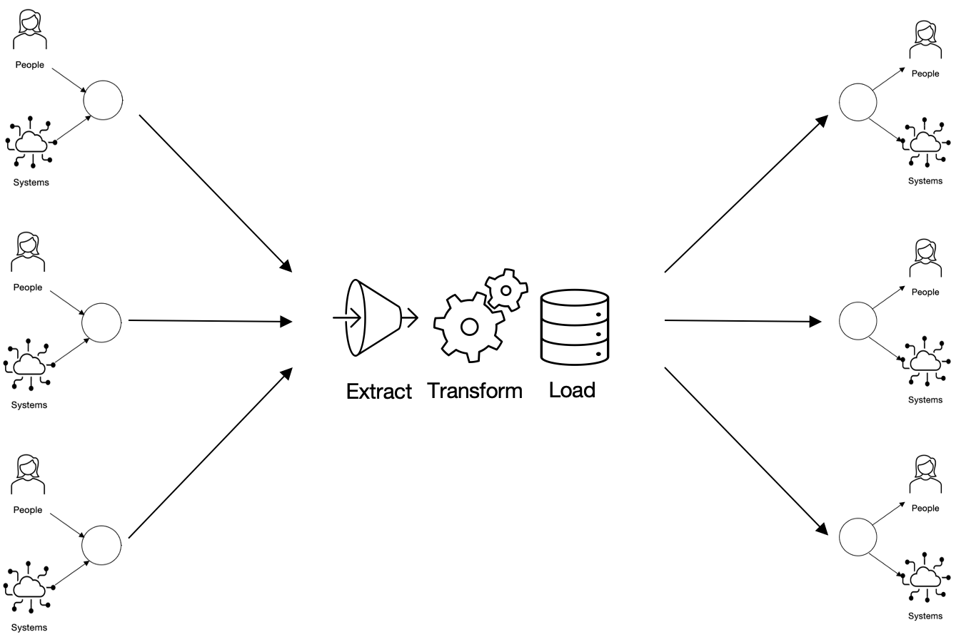
Extract
The act or process of retrieving data from data sources for further processing or storage

Slide 3
Transform
A set of rules or functions applied to acquired data to prepare it for loading into the target system

Slide 4
Load
transferring data to the target storage: flat file, database or warehouse

Slide 5
Batch processing
Simultaneous processing of large amounts of data using scheduled tasks
event data, generated by users
data aggregation
continuous data transformation
data consumer

Slide 6
Stream processing
Takes place in near real-time - data is processed as it arrives.
Examples: payment processing and fraud detection.
event data, generated by users
continuous data transformation
continuous data transformation
data consumer
event data, generated by sensors
continuous data transformation

Slide 7
ETL: processing data before loading
challenges

Slide 8

Too much data
The amount of data being generated is growing
Transformation scripts can count millions of lines. This can make scaling the ETL pipeline very difficult.
Transforming all the data before it is loaded may be unnecessary. For example, it may not be necessary to process all the event data generated on a web page at once.

Slide 9
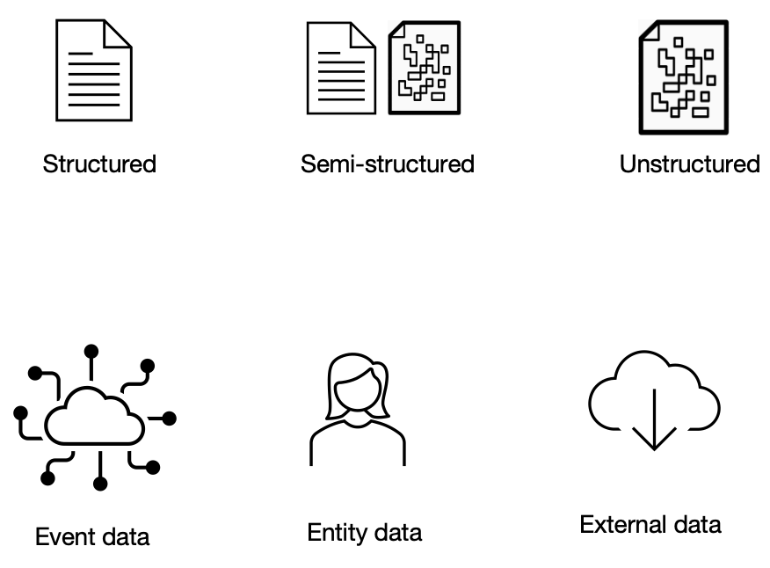
Different data types
Different types of data (structured, unstructured, entity or events) require different transformation methods.
ETL works best with structured, entity data

Slide 10


When to use ETL?
Transaction data (online)
Customer data
Product data
Transaction data
Customer data
Product data

Slide 11
Data processing
ELT: Extract > Load > Transform

Slide 12
ELT: Extract > Load > Transform
Data of different types (structured, unstructured or semi-structured) are retrieved from different sources.
They are then loaded into a data store, such as a data lake.
Transformation occurs after loading into the lake
The transformed data is passed on for further use.

Slide 13
ELT: Challenges
They are expensive:
Lots of data of different types
Requires scalability
Require a lot of resources (storage, processing)
Are relatively new:
and as a result may be less reliable than ETL
Difficult to find specialists
More difficult to ensure security

Slide 14
ELT: When to use?
When collecting large amounts of data
There is no point in processing them before loading
Data is unstructured or mixed. Example: data for sentiment analysis (reviews, emails, stars)

